Slide 1
Cosmetic eCommerce
Technical Presentation

Slide 2
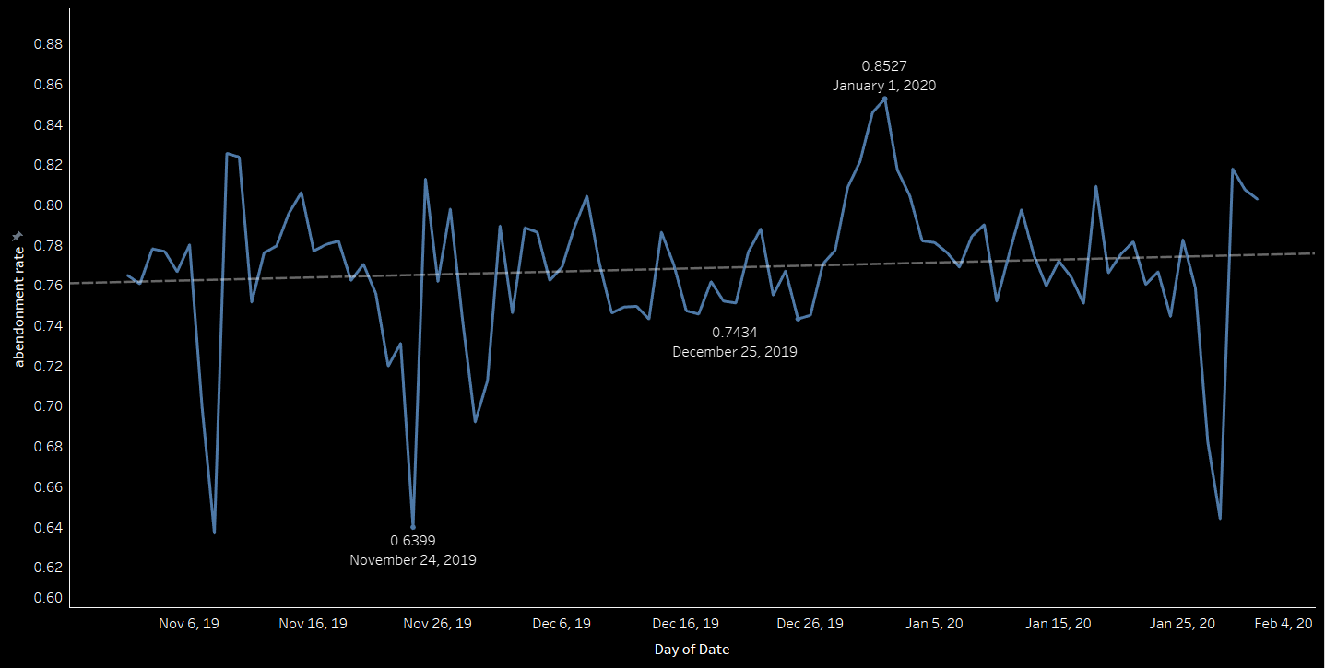
An average increase of 2.3% in cart abandonment during the period of November 2019 and January 2020, had contributed to an average revenue loss of $2.7M. Further analysis reveals that the regression line has a positive slope of 0.00015 and an intercept of -5.7, indicating that cart abandonemnt could be reduced over time.
Source: Kaggle - eCommerce Events History in Cosmetics Shop (November 2019 – January 2020)

Slide 3
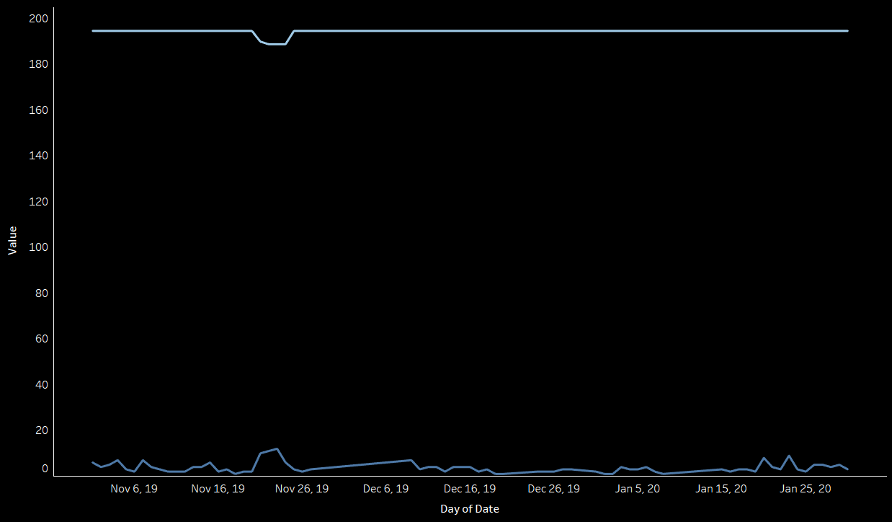
Further pricing analysis of the top three selling products during November 2019 and January 2020, has revealed that these are elastic products, indicating that an increase in their price will lead to a decrease in demand.
Price Elasticity – Product 1 (e(p) > 1)
Source: Kaggle - eCommerce Events History in Cosmetics Shop (November 2019 – January 2020)

Slide 4
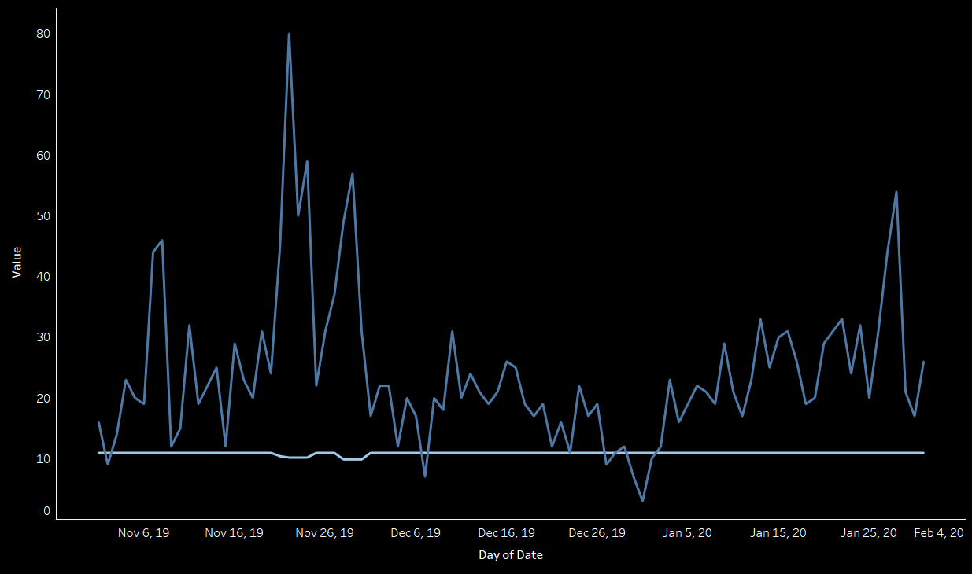
Price Elasticity – Product 2 (e(p) > 1)
Source: Kaggle - eCommerce Events History in Cosmetics Shop (November 2019 – January 2020)

Slide 5
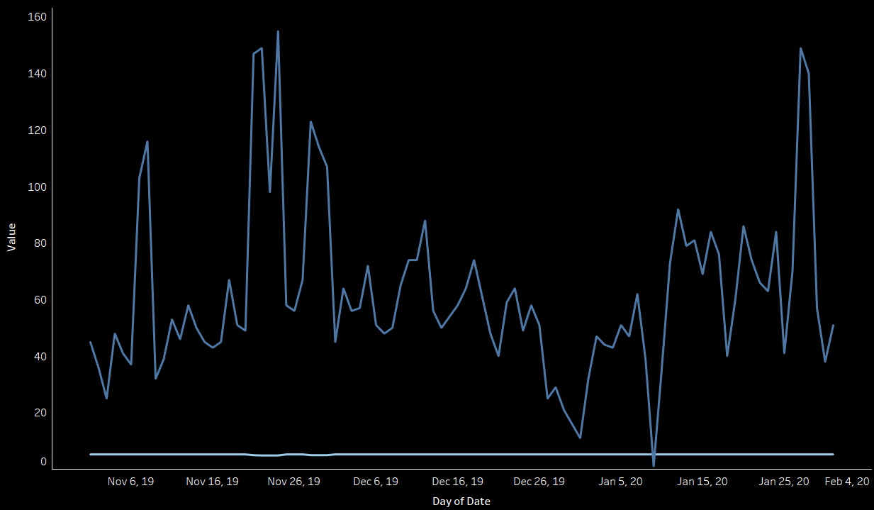
Price Elasticity – Product 3 (e(p) > 1)
Source: Kaggle - eCommerce Events History in Cosmetics Shop (November 2019 – January 2020)

Slide 6
Thank You!

